Slide 1
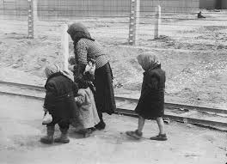
Approaches to Auschwitz
Prologue
GIS 4641
Approaches to Auschwitz

Slide 2
The Horst Wessel Song
The Horst Wessel Song
Flag high, ranks closed,
The S.A. marches with silent solid steps.
Comrades shot by the red front and reaction
March in spirit with us in our ranks.
The street free for the brown battalions,
The street free for the Storm Troopers.
Millions, full of hope, look up at the swastika;
The day breaks for freedom and for bread.
For the last time the call will now be blown;
For the struggle now we all stand ready.
Soon will fly Hitler-flags over every street;
Slavery will last only a short time longer.
Flag high, ranks closed,
The S.A. marches with silent solid steps.
Comrades shot by the red front and reaction
March in spirit with us in our ranks.

Slide 3
Terms
Holocaust (2)
  Systematic
  State-organized
  Persecution and murder
  Approximately six million Jews
  Nazi Germany and collaborators
Final Solution (3)
Shoah (4)

Slide 4
“Nazis” or “Germans”
Not all Germans were Nazis
  “Nazis” were members of the Nazi Party
Not all Nazis were perpetrators
Not all perpetrators were Nazis or Germans
  Therefore, which term is used depends on context
“. . . Use Nazi when we refer to the ideology and actions of the Nazi Party. Germans will refer to acts, institutions, and laws of the state of Nazi Germany or of the Third Reich” (380)

Slide 5
Terms
Witness-people myth
  “. . . the belief that what happens to the Jews, for good or ill, involves God’s providential justice” (20).
    Since the Holocaust was obviously “for ill,” why would God punish the Jews so horribly?
      Traditional Christianity would answer: for killing Christ (deicide) and continuing to reject Him as the messiah
      Traditional Judaism would answer: for abandoning the ways of Torah

Slide 6
Why the focus on the Jews?
The Nazi characterization of the Jews
  An existential threat to the world
  The source of all evil; a cosmic battle
  The ultimate religious, cultural, financial and political “other”
The Nazi intention regarding the Jews
  To create a world that is Judenfrie (free of Jews)
  This requires the murder of every Jewish man, woman and child

Slide 7
Concepts and Observations
“Whenever and wherever a definable population—for whatever reason—can find no viable place in the society it inhabits, that population’s very existence may be at risk.” (3)

Slide 8
Concepts and Observations
“‘The missionaries of Christianity had said in effect: You have no right to live among us as Jews. The secular rulers who followed had proclaimed: You have no right to live among us. The German Nazis at last decreed: You have no right to live.’” (Raul Hilberg, 9)

Slide 9
Concepts and Observations
“. . . the Nazi experiment proved that a highly advanced society, steeped in music, art, philosophy, and literature, is not immune to propaganda that teaches people to kill” (13).
“. . . Holocaust-related literature often raises questions . . . whether belief in God, at least in terms of the ways that Jews and Christians have tended to think about divinity, can be credible after the Holocaust (14).

Slide 10
Concepts and Observations
“. . . any tendency to see the Holocaust . . . as . . . irrational ignores the fact that there was a certain logic, at once forceful and compelling, at work within them” (18).

Slide 11
Concepts and Observations
The uniqueness of the Holocaust
  (Characterization of the Jews)
  (Universal extermination with no exceptions)
  “. . . no genocide other than the Holocaust is so deeply connected with the traditions of biblical religion.” (20)
    Was this punishment by God? If so, for what?
    How can it be perpetrated by baptized Christians?
    Are traditional concepts of God credible after the Holocaust?

Slide 12
Concepts and Observations
“. . . if there is an ideology steeped in racial antisemitism, a dedicated cadre of political leaders who are profoundly committed to it, and a populace that eventually is willing to follow where those leaders and their ideology take them, then one can go far in explaining why the Holocaust happened” (107).

Slide 13
UN Convention on the Prevention and Punishment of Genocide
Article 2:
  In the present Convention, genocide means any of the following acts committed with intent to destroy, in whole or in part, a national, ethnical, racial or religious group, as such:
    (a) Killing members of the group;
    (b) Causing serious bodily or mental harm to members of the group;
    (c) Deliberately inflicting on the group conditions of life calculated to bring about its physical destruction in whole or in part;
    (d) Imposing measures intended to prevent births within the group;
    (e) Forcibly transferring children of the group to another group.

Slide 14
Approaches to Auschwitz
Chapter 4
GIS 4641
Approaches to Auschwitz

Slide 15
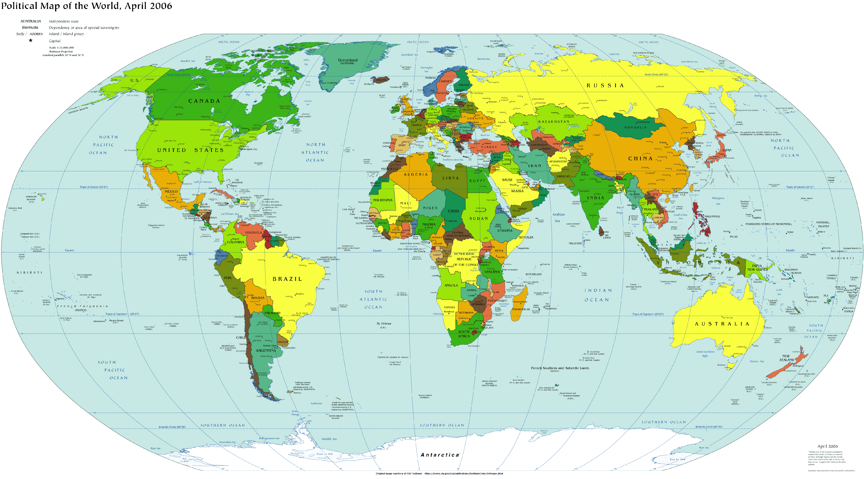

Slide 16
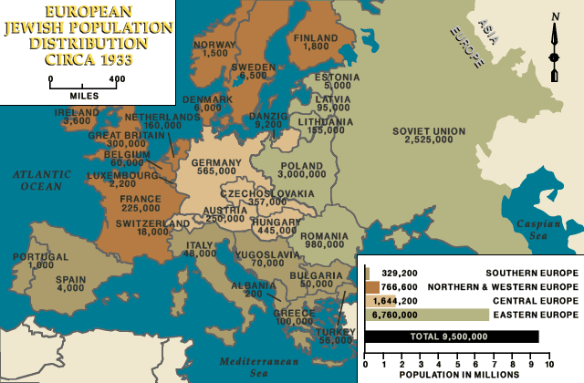

Slide 17
Adolf Hitler
Born 1889 in Austria
Lived in Vienna and Munich
Served (with distinction) in World War I
  “Twentieth-century mass slaughter began in earnest with World War I, Europe’s first industrial war” (100).
  Embittered returning veterans and the German population generally felt humiliated by the loss and blamed it on the Jews’ “stab in the back”

Slide 18
The Rise of the Nazi Party
In 1919 Hitler joined the German Workers Party (DAP)
  Became its leader
  Changed name to the National Socialist German Workers Party (NSDAP): the Nazi Party
First effort to lead revolt – “Beer Hall Putsch of 1923” – failed and led to the death of four policemen and Hitler’s arrest
  Served nine months in prison and considered a hero

Slide 19
Adolph Hitler and the Rise of the Nazi Party
Key Nazi ideological concepts (in addition to antisemitism):
  Race
    A person’s race is determined by his/her blood, which determines all immutable characteristics of that person and related group
    There is a hierarchy of races, with the Aryans at the top, the Slavs towards the bottom, and the Jews at the very bottom as nonhumans
  Volk
    An almost mystical sense of the German people united and sharing a memory of historical German greatness; the “us” that is distinct from “them”
  Social Darwinism
    The application of Darwin’s concept of “survival of the fittest” to people, groups, and countries; those that are powerful deserve to be in power; those that are weak deserve to be subservient to the powerful
  Lebensraum (living space)
    For a country to fulfill its preordained greatness it must have space—land and resources—to expand
    Combining this with the concept of Social Darwinism means that the powerful deserve the land and resources of the weak

Slide 20
Adolph Hitler and the Rise of the Nazi Party
Key Nazi ideological concepts:
  Gleichschaltung
    Literally “same switch” but better to think of it as “on the same page”
    It results in the “Nazification” of every aspect of society
Antisemitism was not the Nazi Party’s only appeal
  Anti-communism (Raterepublik in Munich, April-May, 1919)
  Renewal of the economy
  Restoration of Germany’s place in the world
  Restoration of the old (pre-modern) values
  Abrogation of the terms of the Treaty of Versailles
  The 25 Points of Hitler’s Nazi Party

Slide 21
The Rise of the Nazi Party
Although the Party won only 2.6% of the popular vote in 1928, by 1933 Hitler was “the Fuhrer”
  This was accomplished by winning elections, not by a violent seizure of power

Slide 22
The Rise of the Nazi Party
Hitler consolidated power by:
  February 1933: the Reichstag fire
  March 1933: the Enabling Act
  April 1933: boycott of Jewish businesses
  July 1933: the Vatican Concordat
  July 1933: sterilization of “asocials”
  June 1934: the “Night of the Long Knives”

Slide 23
Conditions that Increased
Hatred Towards the Jews
“As history testifies, economic instability typically intensifies ethnic and religious intolerance” (112).
“. . . Jews . . . threatened to destabilize traditional German society by their liberal democratic leanings . . .” (113)
Competition between the Jews and the lower middle class

Slide 24
Terms (from Prologue)
Intentionalism and functionalism (p. 11, ftn 20 to p. 382)
  Intentionalism
    The Nazis intended from the very beginning to annihilate the Jews
    This was a top-down decision
  Functionalism
    The Nazis came to the Final Solution only after trying to rid Germany and German-occupied territories through other means (perhaps late 1941)
    This was an on-the-ground decision

Slide 25
The Road to the
Final Solution
“. . . the road to Auschwitz was anything but straight and narrow” (114)
  “. . . during the initial years of Hitler’s rule ‘the Nazis stumbled toward something resembling a Final Solution to the Jewish Problem. The Final Solution as it emerged in 1941 and 1942 was not the product of a grand design. In fact, when the Nazis came to power, they had no specific plans for a solution of any sort. They were certain only that a solution was necessary: This commitment carried the Nazi system along the twisted road to Auschwitz’” (Karl A. Schleunes, quoted on 114).

Slide 26
The Road to the
Final Solution
According to Rubenstein and Roth:
  (1) By 1941, a systematic plan for annihilation of the Jews was being implemented
  (2) Despite no written order by Hitler, it is impossible to think that something so vast would have been done unless Hitler decided to do it
  (3) Prior to 1939 and the beginning of the war, Hitler did not have the opportunity to proceed with annihilation of the Jews
  (4) Robert Gellately has written: “‘Until the late 1930s,’ … ‘antisemitism was not the primary concern of the public, most Germans were not rabidly antisemitic, and pushing out the Jews was not the top priority of the German state’” (114-5).

Slide 27
The Road to the
Final Solution
Note, however, this line from a speech by Hitler on January 30, 1939”
  “If the international Jewish financiers in and outside Europe should succeed in plunging the nations once more into war, then the result will not be the Bolshevization of the earth, and thus the victory of Jewry, but the annihilation of the Jewish race in Europe.”
Notes:
.

Slide 28
Approaches to Auschwitz
Chapter 5
Approaches to Auschwitz
GIS 4641

Slide 29
“Rational Antisemitism”
The Nazis pursued a variety of “rational” and “systematic” steps to meet Hitler’s objective:
  “‘Rational antisemitism . . . must lead to a systematic legal opposition and elimination of the special privileges which Jews hold . . . Its final objective must unswervingly be the removal . . . of the Jews altogether.’” (121).
This was in contrast to what Hitler termed “emotional antisemitism”

Slide 30
“Rational Antisemitism”
Hitler wrote in Mein Kampf:
  “‘. . . today I believe I am acting in accordance with the will of the Almighty Creator: by defending myself against the Jew, I am fighting for the work of the Lord’” (122).

Slide 31
“Paper Violence”
Initially Hitler looked to “passive antisemitism” rather than “hooliganism”
  This involved a series of laws that served to increasingly separate and subjugate Jews with the hope that they would choose or be forced to leave Germany. (122-125)

Slide 32
“Paper Violence”
1933: One-day boycott of Jewish businesses; Jews prohibited from owning land; Jews can no longer be newspaper editors
1934: Jews not allowed national health insurance
1935: Jews banned from serving in the military;
1937: Jews banned from many occupations;
1938: Jews register wealth, property, businesses; Jews over age 15 to carry identity cards

Slide 33
“Paper Violence”
1935: the Nuremberg Laws
  Jews were no longer considered to be citizens
  Jews and non-Jews could not marry or have sexual relations
Focus on defining a “Jew”
  If 3 or 4 Jewish grandparents, you were a Jew
  If 1 or 2 Jewish grandparents, you were a Mischling, meaning a “mixed breed”

Slide 34
“Paper Violence”
1938: Jews banned from practicing medicine and law; men are “Israel,” women are “Sarah”; “J” is stamped on passports; Jewish pupils are expelled
1939: Jews required to forfeit gold and silver items; lose rights as tenants and are relocated; not permitted to be outside at night; forbidden to own radios; Polish Jews over age 10 required to wear yellow stars

Slide 35
Kristallnacht
November 9-10, 1938: a pogrom carried out by the Nazis in Germany and Austria
  In retaliation for assassination of a German embassy official in Paris
  Shop windows of Jewish businesses were smashed; stores were looted; synagogues and Jewish homes were burnt down; Jews were assaulted; 800 Jews killed; 30,000 Jews were arrested and sent to concentration camps
  Changed Nazi treatment of Jews to use of violence

Slide 36
The Next Step:
Forced Emigration
Forced emigration of Jews to other countries (e.g., Madagascar) failed for a number of reasons:
  The global economic depression
  The fact that the Jews’ “predominantly professional and business skills” (as compared to craft and industrial skills) were seen as a disadvantage
  The “rising average age among Jews”
  “Antisemitic feeling in other nations”;
  “Most German Jews . . . thought of themselves as thoroughly German.” (139)

Slide 37
The Next Step:
Forced Emigration
Forced emigration of Jews to other countries failed for another reason: virtually no country in the world wanted them
  The Evian Conference convened on July 6, 1938. (139-140)
    “. . . the world was divided into two camps—one that wanted to be rid of Jews and one that would not accept them” (140).
  Jews found their way to Palestine despite severe restrictions imposed by the British
  Despite the talents of the Jews, “Nazi Germany weighed those assets and found them wanting in comparison to the gain that would accrue if the Jewish presence disappeared. . . . If actions speak louder than words, other nations in the world were not opposed to this Nazi sentiment” (142).
  “‘I believe,’ Goebbels wrote in his diary entry for 13 December 1942, ‘that both the English and the Americans are happy that we are exterminating the Jewish riffraff’” (142).

Slide 38
Approaches to Auschwitz
Chapter 6
Approaches to Auschwitz
GIS 4641

Slide 39
Two Wars
The war in the west: “the basic norms were more or less observed”
The war in the east: “an uncompromisingly, racially motivated war of conquest, colonization, demographic revolution, and extermination” (144)
  With each military success, the number of Jews under Nazi rule increased
  Hitler’s concept of “Judeo-Bolshevism”

Slide 40
Two Observations
Scholars’ initial assumption that “the German people had no knowledge of mass murder” has changed
“Although Germany had several million Jews under its control between September 1933 and June 1941, no systematic program of overt and unremitting genocide was initiated until after the invasion of the Soviet Union on 22 June 1941” (emphasis in original) (146).

Slide 41
Two Terms
Freikorps
  Private, right-wing paramilitary units
  Composed primarily of returning WW I veterans
Einsatzgruppen
  Mobile killing units who followed the regular German army into conquered territories (e.g., Poland and Russia) specifically to kill surviving Jews

Slide 42
Hitler’s Two Goals
Hitler sought to facilitate:
  “. . . a grandiose program of demographic engineering
  based on racial principles
  that would involve the uprooting of millions of people.
  . . . Hitler’s . . . intentions . . . went in two directions at once:
    Germans, including ethnic Germans, would occupy the newly acquired Lebensraum;
    concurrently, that territory would be ethnically cleansed. . . . Germans in; Jews out” (150).

Slide 43
The Division of Poland
Germany and Russia secretly agreed to split Poland between them:
  Russia in the east
  Germany in the west
    Much of western and northern Poland was annexed to the Reich (called the Warthegau)
    The central region became a German-occupied zone (called the Generalgouvernement)
      Hans Frank was governor
      Became the “dumping ground” for Jews

Slide 44
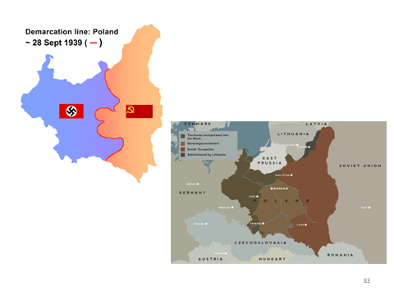

Slide 45
Ghettoization
In order to “store” the Jews in the General Government until a solution could be determined, compulsory ghettoization was instituted as an interim stage on the road to the “‘final goal’” (161).
  “‘The creation of the ghetto is of course only a provisional measure. . . . The final goal, at any rate, must be to lance this festering boil’” (Friedrich Uberlhoer; italics added by R&R) (162).

Slide 46
Lodz and Warsaw
The Lodz ghetto was the first major ghetto
  160,000 Jews in an area of 1.54 square miles
  Internally governed by a Judenrat (Jewish Council), headed by Chaim Rumkowski
  The ghetto was liquidated in August 1944 (163)
The Warsaw ghetto was sealed on November 15, 1940 (Jews were told on Yom Kippur)
  450,000 Jews in an area of 1.3 square miles
  “The hideous conditions were meant to kill the Jews with the least possible German effort” (165).

Slide 47
Murder of the Disabled:
Aktion T-4
In the Fall of 1939, Hitler issued the following order:
  “certain physicians” shall determine if “persons, who according to human judgment, are incurable can, upon a most careful diagnosis of their condition of sickness, be accorded a mercy death.”
A bureaucracy was created to implement what was called the Aktion T-4 Euthanasie Operation
  Named after its headquarters at Tiergartenstrasse 4
  Relied on doctors and university professors for “legitimization”

Slide 48
Murder of the Disabled:
The German Medical Community
Doctors and heads of medical departments of universities were critical to the development and implementation of the program
All killings were to be “mercifully” administered by physicians
The German medical community:
  Continued with the program even after Hitler stopped the official program in response to negative public opinion
  On May 23, 2012, apologized for its actions

Slide 49
The Churches’ Responses
“By 1941 protests [against the Aktion T-4 killings] were heard from some highly influential German church leaders. The most important of these protests was a sermon preached on 3 August 1941 by Clemens August Graf von Galen, the Roman Catholic bishop of Munster. Another important opponent of the program was Theophil Wurm, the Lutheran bishop of Wurttemberg. . . . there were no such overt protests by German church officials concerning the Final Solution” (157).
“The Vatican’s response to the euthanasia program was more muted” (157). An opinion which seemed to be endorsed by the papal nuncio (ambassador) to Germany concluded that “since there were reasonable grounds pro and con as well as Catholic authorities on both sides, euthanasia of the mentally incompetent could be considered ‘defensible.’” This “signaled that there would be no serious Vatican opposition” (158).

Slide 50
Approaches to Auschwitz
Chapter 7
Approaches to Auschwitz
GIS 4641

Slide 51
Some Terms
SS
  Schutzstaffel (protection squadron or defense corps)
  Paramilitary organization headed by Heinrich Himmler
  Members of the SS were considered to be:
    The elite in terms of racial purity and loyalty to Hitler
    The main perpetrators of the genocide

Slide 52
Some Terms
Einsatzgruppen
  Mobile killing units who followed the regular German army into conquered territories to kill surviving Jews (chapter six)
  “. . . the Einsatzgruppen . . . were the main perpetrators of the Holocaust prior to the establishment of major killing centers on Polish soil in 1942” (173).
  “The Einsatzgruppen . . . leadership . . . were predominantly respectable, well-educated, upper-middle-class professionals. They were not bloodthirsty killers, certainly not the scum of German society or even career SS men. . . . these murderers were a representative cross section of well-educated, respectable Germans in the Third Reich. . . . Recent research . . . shows that . . . there was considerable enthusiasm for the indiscriminate killing of Jews” (174).

Slide 53
Some Terms
Operation Barbarossa
  On June 22, 1941, in excess of three million German troops invaded Russia (contrary to the nonaggression pact between the two countries)
  After making rapid and dramatic advancement, the Germans were not prepared for the Russian winter.
  The Germans advanced within sight of Moscow in late 1941. Stalin's troops defended Moscow and drove the Germans back. (http://www.u-s-history.com/pages/h1761.html)
Notes:
S

Slide 54
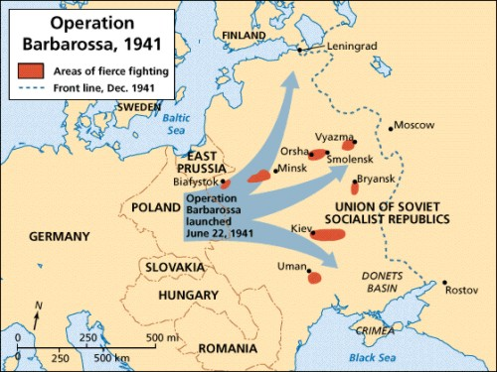
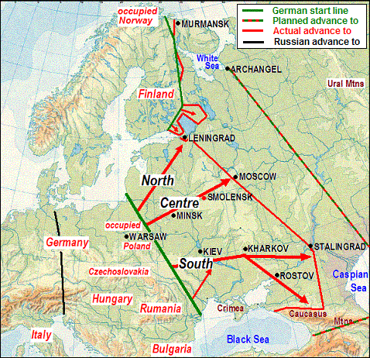

Slide 55
Some Terms
Wehrmacht
  “The Wehrmacht consisted of the German army, navy, and air force” (407).
  By contrast to the SS, “the Wehrmacht . . . was not an organization separate from the German people; it was the German people in its most important wartime activity. . . . to indict the Wehrmacht as a criminal organization would have been tantamount to indicting the entire German people as criminal” (168).

Slide 56
What Did the Wehrmacht Do?
“Although the military leaders [of the Wehrmacht] were asked to conduct an unprecedented war of annihilation of unarmed civilians, unlike any ever fought before on the European continent, they offered no protest. On the contrary, they welcomed Hitler’s views . . .” (167)

Slide 57
Examples of the
Wehrmacht’s Involvement
In Operation Barbarossa
  “. . . the Wehrmacht High Command agreed on the Army’s close cooperation with the Einsatzgruppen” (174).
  “In addition to facilitating the efforts of the Einsatzgruppen, the Wehrmacht often went out of its way to turn over Jews to the Einsatzgruppen and to request their speedy dispatch. Moreover, the army frequently participated in the killing. German military leaders fully understood the Einsatzgruppen’s mission, agreed to it, and helped to move the process along. The extermination program was popular with the generals” (175).

Slide 58
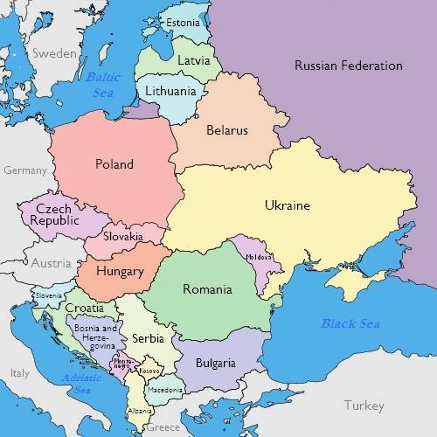

Slide 59
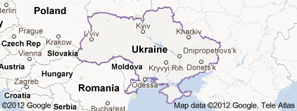
Babi Yar
A ravine northwest of Kiev
On September 29-30, 1941, SS and German police units and an Einsatzgruppen unit, murdered the Jewish population of Kiev.
  “sardine packing” was used as part of a “rationalized, assembly-line” process. (179).
This was one of the largest mass murders at an individual location during World War II. As the victims moved into the ravine, Einsatzgruppe detachments shot them in small groups. Approximately 33,771 Jews were massacred in two days.
Babi Yar survivor

Slide 60
The Holocaust by Bullets
With regard to the actions of the Einsatgruppen and similar killing units:
  “‘the gas chambers and crematoria of the death camps have come to typify the Holocaust, . . . they were exceptional. The primary means of mass murder the Nazis deployed during the Second World War was firearms and lethal deprivation’” (181).
  The Holocaust by Bullets: A Priest’s Journey to Uncover the Truth Behind the Murder of 1.5 Million Jews, by Patrick Desbois

Slide 61
The Killing in the Soviet Union and the Final Solution
“. . . the mass murder of Soviet Jews in 1941 did not mean that the Final Solution for all European Jews was under way . . . Einsatzgruppen [units] were operating on a regional basis. Continental plans incorporating killing centers equipped with gas chambers had not yet been developed.
“. . . the decision to murder every last man, woman, and child among Soviet Jewry . . . was not taken until some time after the initial German invasion” (175).
This issue will be discussed in detail in Chapter 8.

Slide 62
Approaches to Auschwitz
Chapter 8
Approaches to Auschwitz
GIS 4641
Notes:
First hyperlink “Approaches to Auschwitz” goes to https://www.pbs.org/wgbh/frontline/film/memory-of-the-camps/ for “Memory of the Camps.”
Second hyperlink “Chapter 8” goes to https://vimeo.com/89396290 for Milgram recreation.
This is the chapter in the book that most focuses on the Final Solution per se: (1) when the decision for the Final Solution was decided, and by whom; (2) the concentration camps, but especially the six extermination camps; (3) the death marches and the most likely explanation for the “German rage” that was reflected in all of these actions.
The chapter’s epigraph tells us what the chapter is about: “The Jewish question takes priority over all other matters” (185).

Slide 63
The Wannsee Conference
January 20, 1942
  Conference—held at a mansion in the Berlin suburb of Wannsee—led by Reinhard Heydrich and attended by heads of Nazi government departments that would carry out the Final Solution
  The “Wannsee Protocol” (notes taken during the meeting )and Adolf Eichmann’s testimony at his 1961 trial make it clear that Heydrich came to the Wannsee Conference meeting to emphasize that “‘overall control’ of that initiative [the Final Solution] rested with Himmler and himself . . .” (191).
Notes:
“Our primary documentary sources concerning the conference consist of the Wannsee Protocol, a sanitized summary—only one copy of thirty, the sixteenth, survived the war . . . [it] is by no means a transcript of the proceedings . . . “ (191).

Slide 64
The Wannsee Conference
January 20, 1942
  Further, the “language [of the Protocol] left no doubt that every European Jew was sentenced to die . . . At his trial, Eichmann stated that . . . they spoke about methods for killing, about liquidation, about extermination” (192).
  They also spoke at length about treatment of Mischlinge, with Heydrich wanting “half Jews to be treated as full Jews” (192).
    Three or four Jewish grandparents = full Jew
    One or two Jewish grandparents = Mischlinge (“mixed breed); part Jewish and part Christian
Notes:
“Our primary documentary sources concerning the conference consist of the Wannsee Protocol, a sanitized summary—only one copy of thirty, the sixteenth, survived the war . . . [it] is by no means a transcript of the proceedings . . . “ (191).

Slide 65
The Wannsee Conference
Roth and Rubenstein write (based on Gerlach):
  The Wannsee Conference did not launch the Final Solution. . . . it did provide . . . ‘the initial sketches of a comprehensive plan for total liquidation.’ . . .”
  “. . . the Wannsee Conference provided crucial, even essential, guidance that death for all of Europe’s Jews was to be the goal . . .”
  The Wannsee Conference could send its signals only because Hitler had first made his objectives clear” (193-4).
Notes:
[Hitler’s] role was central. Without Hitler, there would have been no Final Solution. By no means, however, did Hitler act alone. . . . many different decisions escalated and expanded the mass killing. Their exact timing remains contested . . . (194).

Slide 66
Roth and Rubenstein
Conclude
  “. . . the more we learn about the destruction process, the more incremental, protracted, and complicated it seems to have been. . . .
  Of this much . . . we can be sure: millions of Jews and other victims paid the ultimate price for deliberations of the kind that took place at the Wannsee villa on 20 January 1942; they did so because plans for genocide were not only laid but carried out” (194).

Slide 67
The Extermination Camps:
“Efficient Death”
“Six major killing centers, all of them situated on Polish soil, became operational in an eight-month period from December 1941 to July 1942”
  These were not the same as concentration camps.
    Concentration camps were originally “institutions of incarceration for opponents of the National Socialist regime who had committed no offense punishable in traditional German courts”
    Extermination camps (Killing Centers) “existed for a single reason: the extermination of Jews and Gypsies” (195).

Slide 68
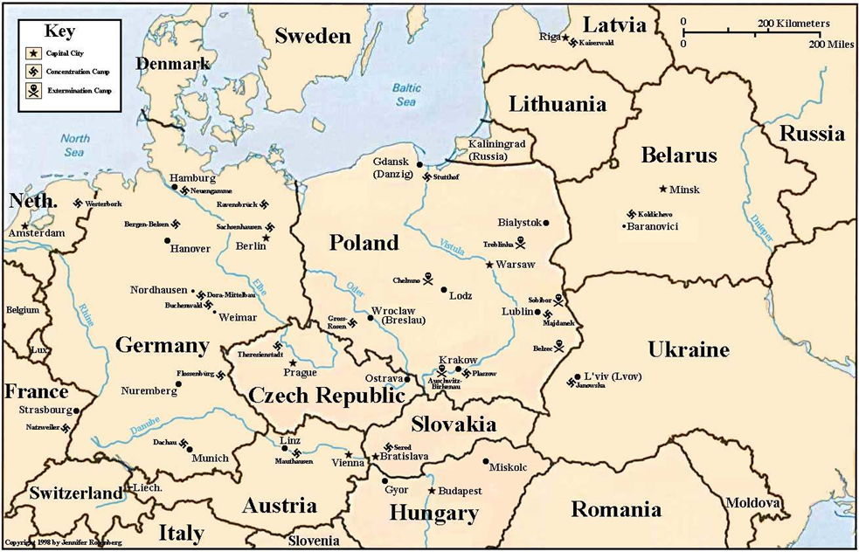

Slide 69
Extermination Camps
Chelmno, in the Warthegau, was the first extermination center. (196-7)
Belzec, Sobibor and Treblinka
  In the General Government
  Established as “Operation Reinhard”
    In remote locations
    Near rail lines and large Jewish populations
    “. . . at the eastern border of the General Government” (198).
    Aktion T4 personnel brought their experience to these camps
Notes:
Only two people known to survive Chelmno . . . (197). Operation Reinhard camps were “. . . named in honor of Reinhard Heydrich after his death on 4 June 1942” (197). Chelmno was in the incorporated territory of Poland. When brought to the village of Chelmno, Jews were told they were had to take a shower before going to Germany. Ordered to strip, they were handed towels and soap and pushed through a corridor labeled “washroom” into waiting vans (about 90 people to a van). The van drove around slowly while carbon monoxide was pumped into the sealed van. Jews who were part of the “Sonderkommando” (special unit) would unload the bodies (about 1,000 a day) and put them into mass graves; other Jews sorted clothing and cleaned the vans. By the summer of 1942 the stench was so terrible that ovens were brought in. From 12/41 to 12/42 about 145,000 people, mostly Jews, were killed there.
Belzec, near the Polish city of Lublin in the General Government territory, began operations in March 1942. Belzec had the a fixed installation for gassing that used diesel fuel. By the spring of 1943 (when the camp was dismantled) 600,000 Jews had died there.
Sobibor (built solely as a killing camp) began mass killing of Jews in April 1942; it closed in October 1943. 250,000 Jews from eastern Poland, the Soviet Union and other European countries were killed there. Trains brought the Jews right into the camp. In October 1943 there was an uprising by Jewish workers who staged a mass escape; some survived.
Treblinka (also built solely for killing) began in July 1942 and was located 80 miles from Warsaw (the General Government territory). Its first victims were 300,000 Jews from Warsaw. Close to a million Jews were killed there.
[Above from GAH 2114 Fall 2011, based on Paul’s book, Surviving the Camps]

Slide 70
Extermination Camps
  Majdanek differed from the above four camps:
    It was near a major city (Lublin)
    It was a concentration camp
    “. . . the 300,000 prisoners who passed through Majdanek were highly diverse” (202).
Notes:
Majdanek was a labor camp and a killing center, a mile from the city of Lublin. Built in the winter of 1940-1, gas chambers were added in 1942. 200,000 people were killed there, 125,000 of whom were Jews.
[Above from GAH 2114 Fall 2011, based on Paul’s book, Surviving the Camps]

Slide 71
Extermination Camps
Auschwitz as “Michael Berenbaum has said. . . will always be the Holocaust’s emblematic camp. . . . It was the most extreme and intensified manifestation of Nazi evil” (203).
  Auschwitz I: the main camp
  Auschwitz II or Birkenau: the extermination camp
  Auschwitz III/Monowitz/Buna: the factory camp
“Himmler appointed SS Captain Rudolf Höss... to be the camps’ commandant” (203).
Notes:
Auschwitz was established, with its initial batch of prisoners arriving in July 1940. Auschwitz (covering 15 square miles and consisting of three camps and many sub-camps) was not established on the Dachau model; it had different purposes. It was intended to terrorize the local Polish population. It also was seen as an economic resource since the region had raw materials valuable to the Nazis. Thus, it initially was a camp for Poles, not Jews, and it was seen as a source of labor and resources. It was the first created outside of the Old Reich. As such, Auschwitz was the first of what would become a continent-wide phenomenon, with camps in Austria, Belgium, Bulgaria, Czechoslovakia, France, Germany, Greece, Italy, Lithuania, Luxembourg, Netherlands, Norway, Poland, Roumania, and Yugoslavia (among other countries).
[Above from GAH 2114 Fall 2011, based on Paul’s book, Surviving the Camps]
Auschwitz grew in size because I.G. Farben, wanting to take advantage of slave labor, opened a factory site there, and it was the place where hundreds of thousands of Soviet POWs were sent.

Slide 72
Extermination Camps
Auschwitz:
  “Between 31 March and 26 June 1943 four state-of-the-art crematoria came on line. . . . these structures . . . included eight gas chambers, forty-six ovens, and the capacity to dispose of 4,416 corpses a day” (205).
    “Several German companies . . . profited by supplying Zyklon B [which was the gas used at Auschwitz] to the SS” (206).
Gypsies were murdered in large numbers at Auschwitz
  “. . . Europe’s Gypsy population was the one whose treatment by Nazi Germany most closely resembled the genocidal fate of Jews . . .” (206).

Slide 73
Extermination Camps
    “The year 1942 was the most lethal in Jewish history. During those twelve months, the killers who implemented Nazi Germany’s Final Solution murdered 2.6 million Jews” (199)
“At the beginning of 1942, even after three years of war, ghettoization, torture, and forced labor, 75 percent of the Jews who would be murdered in the Holocaust were still alive. By the beginning of 1943, 75 percent of the approximately 6 million who would be killed were already dead” (Bergen, War and Genocide, 182-183).

Slide 74
Death Marches
As the war was coming to a close, death marches were begun:
  Effort to cover up horror of the camps
  “. . . no one in Germany could believe in a German victory, but the cruelty inflicted on the Jews remained unrelenting” (209).
Notes:
Forced marches took place “during the winter of 1944-45 . . . The term death march, however, understates the reality to which it refers. Daniel Goldhagen rightly speaks of extermination marches” (208).

Slide 75
Death Marches
Contrary to scholars who have stressed “the cool, rational, bureaucratic character of the extermination process . . . many Germans were also seething with hatred toward their victims.”
How to explain “the possible motives for the seemingly purposeless German rage that could not be stilled as long as even one Jew remained alive . . .?”

Slide 76
Roth and Rubenstein Explain
“. . . one explanation stands out as most plausible: starting in 1919, the steadily mounting propaganda of the German right held that the Jews had brought about Germany’s downfall in World War I and were plotting to finish the job in World War II. This outlook had captured the minds and hearts of millions of Germans who should have known better. This was especially true of the SS and the military. As the war drew to a close, many Germans shared Hitler’s view that the defeat of their country would be a victory for the Jews. . . (continued →)
Notes:
VERY IMPORTANT: R&R write that

Slide 77
Roth and Rubenstein
Explain
“In their minds, once again it was the Jews who had defeated their beloved land and had, this time, opened the gates to the conquest of their cherished Heimat (homeland) by the barbaric forces of Judeo-Bolshevism. If they could not defeat this enemy, they could at least vent their hatred and wreak their vengeance on the Jews under their control and do so in the cruelest possible way” (211).
Notes:
“. . . this explanation is consistent with the following:
-- Hitler’s ‘prophecy’ of 30 January 1939 and his subsequent repetitions of that prophecy both before and after the decision was taken to implement the Final Solution fully
-- The summer 1941 decision, supported by the Wehrmacht, to murder Soviet Jewry, save for a small number of especially useful skilled workers and professionals
-- Christian Gerlach’s theory concerning the timing and the motivation for Hitler’s decision to murder the Jews of Gemany, which emphasizes Hitler’s belief that, with America’s entry into the war, the Jews had succeeded in bringing Germany into a world war
-- The findings of Robert Gellately and others who reliably stress, in Gellately’s words, that ‘the great majority of German people [were] devoted to Hitler and they supported him to the bitter end’
-- Hitler’s political testament composed in his Berlin bunker on 29 April 1945 a few hours before his suicide” (211-212)

Slide 78
Roth and Rubenstein Conclude
“Hitler’s lie that the Jews were responsible for all the ills that had befallen Germany . . . permitted millions of Germans to believe that . . . the annihilation of millions of unarmed men, women, and children was . . . ethically justified. . . . the German people did not follow Hitler primarily because of coercion or fear. To a genocidal extent, they followed him as full partners until the killing ended” (213).
Notes:
How “Goldhagenian.”

